Slide 1

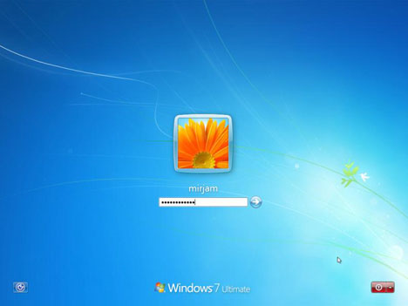
Authentication & Authorization in ASP.NET
Forms Authentication, Users, Roles, Membership
Svetlin Nakov
Telerik Corporation
www.telerik.com

Slide 2


Table of Contents
Basic principles
Authentication Types
Windows Authentication
Forms Authentication
Users & Roles
Membership and Providers
Login / Logout Controls

Slide 3
Basics
Authentication
The process of verifying the identity of a user or computer
Questions: Who are you? How you prove it?
Credentials can be password, smart card, etc.
Authorization
The process of determining what a user is permitted to do on a computer or network
Question: What are you allowed to do?

Slide 4

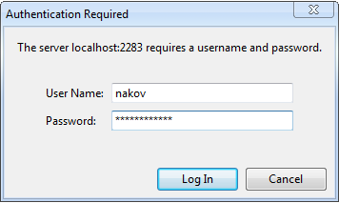
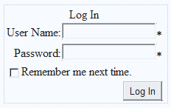
Windows and Form Authentication in ASP.NET

Slide 5
Authentication Types in ASP.NET
Windows Authentication
Uses the security features integrated into the Windows operating systems
Uses Active Directory / Windows accounts
Forms Authentication
Uses a traditional login / logout pages
Code associated with a Web form handles users authentication by username / password
Users are usually stored in a database

Slide 6
Windows Authentication
In Windows Authentication mode the Web application uses the same security scheme that applies to your Windows network
Network resources and Web applications use the same:
User names
Passwords
Permissions
It is the default authentication when a new Web site is created

Slide 7
Windows Authentication (2)
The user is authenticated against his username and password in Windows
Known as NTLM authentication protocol
When a user is authorized:
ASP.NET issues an authentication ticket (which is a HTTP header)
Application executes using the permissions associated with the Windows account
The user's session ends when the browser is closed or when the session times out

Slide 8
Windows Authentication (3)
Users who are logged on to the network
Are automatically authenticated
Can access the Web application
To set the authentication to Windows add to the Web.config:
To deny anonymous users add:
<authentication mode="Windows" />
<authorization>
<deny users="?"/>
</authorization>

Slide 9
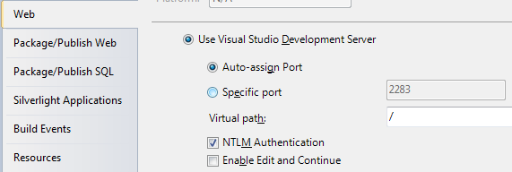
Windows Authentication (4)
The Web server should have NTLM enabled:
HTTP requests:
HTTP responses:
GET /Default.aspx HTTP/1.1
…
HTTP/1.1 401 Unauthorized
WWW-Authenticate: NTLM
GET /Default.aspx HTTP/1.1
Authorization: NTLM tESsB/ yNY3lb6a0L6vVQEZNqwQn0sqZ…
HTTP/1.1 200 OK
…
<html> … </html>

Slide 10
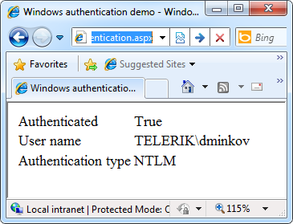
Windows Authentication
Live Demo

Slide 11
Forms Authentication
Forms Authentication uses a Web form to collect login credentials (username / password)
Users are authenticated by the C# code behind the Web form
User accounts can be stored in:
Web.config file
Separate user database
Users are local for the Web application
Not part of Windows or Active Directory

Slide 12
Forms Authentication (2)
Enabling forms authentication:
Set authentication mode in the Web.config to "Forms"
Create a login ASPX page
Create a file or database to store the user credentials (username, password, etc.)
Write code to authenticate the users against the users file or database
<authentication mode="Forms" />

Slide 13
Configuring Authorization in Web.config
To deny someone's access add <deny users="…"> in the <authorization> tag
To allow someone's access add <allow users="…"> in the authorization tag
<deny users="?" /> denies anonymous access
<deny users="*" /> denies access to all users
<system.web>
<authorization>
<deny users="?"/>
</authorization>
</system.web>

Slide 14
Configuring Authorization in Web.config (2)
Specifying authorization rules in Web.config:
The deny/allow stops the authorization process at the first match
Example: if a user is authorized as Pesho, the tag <deny users="*" /> is not processed
<location path="RegisterUser.aspx">
<system.web>
<authorization>
<allow roles="admin" />
<allow users="Pesho,Gosho" />
<deny users="*" />
</authorization>
</system.web>
</location>

Slide 15
Implementing Login / Logout
Logging-in using credentials from Web.config:
Logging-out the currently logged user:
Displaying the currently logged user:
if (FormsAuthentication.Authenticate(username, passwd))
{
FormsAuthentication.RedirectFromLoginPage(
username, false);
}
else
{
lblError.Text = "Invalid login!";
}
This method creates a cookie (or hidden field) holding the authentication ticket.
FormsAuthentication.SignOut();
lblInfo.Text = "User: " + Page.User.Identity.Name;

Slide 16
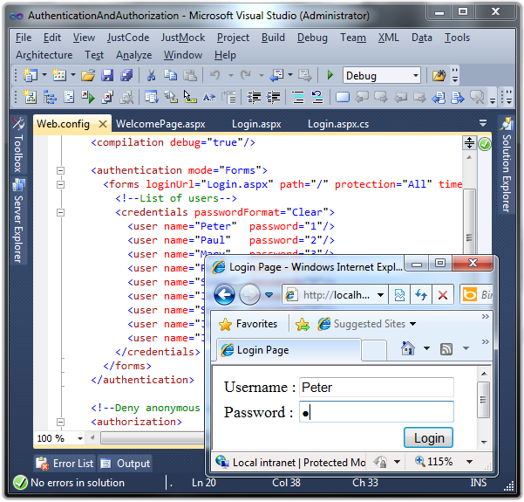
Forms Authentication
Live Demo

Slide 17

ASP.NET Users and Roles
Membership Provider and Roles Provider

Slide 18

Users, Roles and Authentication
User is a client with a Web browser running a session with the Web application
Users can authenticate (login) in the Web application
Once a user is logged-in, a set of roles and permissions are assigned to him
Authorization in ASP.NET is based on users and roles
Authorization rules specify what permissions each user / role has

Slide 19
ASP.NET Membership Providers
Membership providers in ASP.NET
Simplify common authentication and user management tasks
CreateUser()
DeleteUser()
GeneratePassword()
ValidateUser()
…
Can store user credentials in database / file / etc.

Slide 20
Roles in ASP.NET
Roles in ASP.NET allow assigning permissions to a group of users
E.g. "Admins" role could have more privileges than "Guests" role
A user account can be assigned to multiple roles in the same time
E.g. user "Peter" can be member of "Admins" and "TrustedUsers" roles
Permissions can be granted to multiple users sharing the same role

Slide 21
ASP.NET Role Providers
Role providers in ASP.NET
Simplify common authorization tasks and role management tasks
CreateRole()
IsUserInRole()
GetAllRoles()
GetRolesForUser()
…
Can store user credentials in database / file / etc.

Slide 22
Registering a Membership Provider
Adding membership provider to the Web.config
<membership defaultProvider="MyMembershipProvider">
<providers>
<add connectionStringName="UsersConnectionString"
minRequiredPasswordLength="6"
requiresQuestionAndAnswer="true"
enablePasswordRetrieval="false"
requiresUniqueEmail="false"
applicationName="/MyApp"
minRequiredNonalphanumericCharacters="1"
name="MyMembershipProvider"
type="System.Web.Security.SqlMembershipProvider"/>
</providers>
</membership>

Slide 23
Registering a Role Provider
To register role provider in ASP.NET 4.0 add the following to the Web.config:
<roleManager enabled="true"
DefaultProvider="MyRoleProvider">
<providers>
<add connectionStringName="UsersConnectionString"
name="MyRoleProvider"
type="System.Web.Security.SqlRoleProvider" />
</providers>
</roleManager>
<connectionStrings>
<add name="UsersConnectionString"
connectionString="Data Source=.\SQLEXPRESS;Initial
Catalog=Users;Integrated Security=True"
providerName="System.Data.SqlClient" />
</connectionStrings>

Slide 24
The SQL Registration Tool: aspnet_regsql
The built-in classes System.Web.Security. SqlMembershipProvider and System.Web. Security.SqlRoleProvider use a set of standard tables in the SQL Server
Can be created by the ASP.NET SQL Server Registration tool (aspnet_regsql.exe)
The aspnet_regsql.exe utility is installed as part of with ASP.NET 4.0:
C:\WINDOWS\Microsoft.NET\Framework\v4.0.30319\ aspnet_regsql.exe

Slide 25
The Standard ASP.NET Applications Database Schema

Slide 26
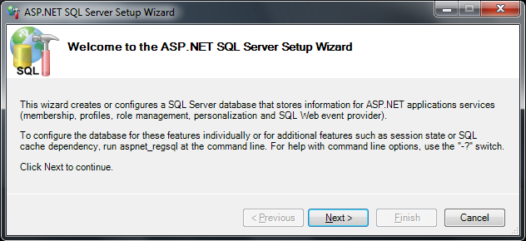
aspnet_regsql.exe
Live Demo

Slide 27
ASP.NET Membership API
Implementing login:
Implementing logout:
Creating new user:
if (Membership.ValidateUser(username, password))
{
FormsAuthentication.RedirectFromLoginPage(
username, false);
}
FormsAuthentication.SignOut();
Membership.CreateUser(username, password);

Slide 28
ASP.NET Membership API (2)
Getting the currently logged user:
Creating new role:
Adding user to existing role:
Deleting user / role:
MembershipUser currentUser = Membership.GetUser();
Roles.CreateRole("Admins");
Roles.AddUserToRole("admin", "Admins");
Membership.DeleteUser("admin", true);
Roles.DeleteRole("Admins");

Slide 29
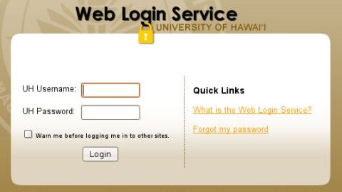
Membership Provider
Live Demo

Slide 30
ASP.NET Web Site Administration Tool
Designed to manage your Web site configuration
Simple interface
Can create and manage users, roles and providers
Can manage application configuration settings
Accessible from Visual Studio:
[Project] menu → [ASP.NET Configuration]

Slide 31
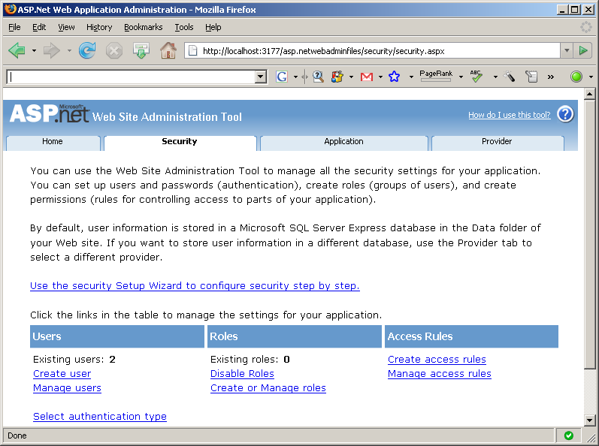
Visual Studio Web Site Administration Tool
Live Demo

Slide 32
Built-in Login Control

Slide 33
The Login Control
The Login control provides the necessary interface through which a user can enter their username and password
The control uses the membership provider specified in the Web.config file
Adding the login control to the page:
<asp:Login id="MyLogin" runat="server"/>

Slide 34
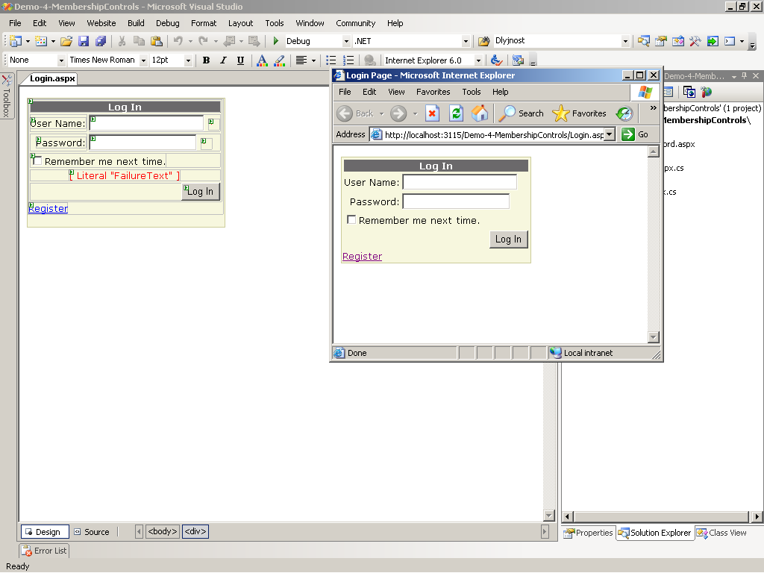
The Login Control (2)

Slide 35
The LoginName and LoginStatus Control
Once a user has logged in we can display his username just by adding the LoginName control to the page
The LoginStatus control allows the user to log in or log out of the application
<asp:LoginName id="lnUser" runat="server"/>
<asp:LoginStatus id=" lsUser" runat="server"/>

Slide 36
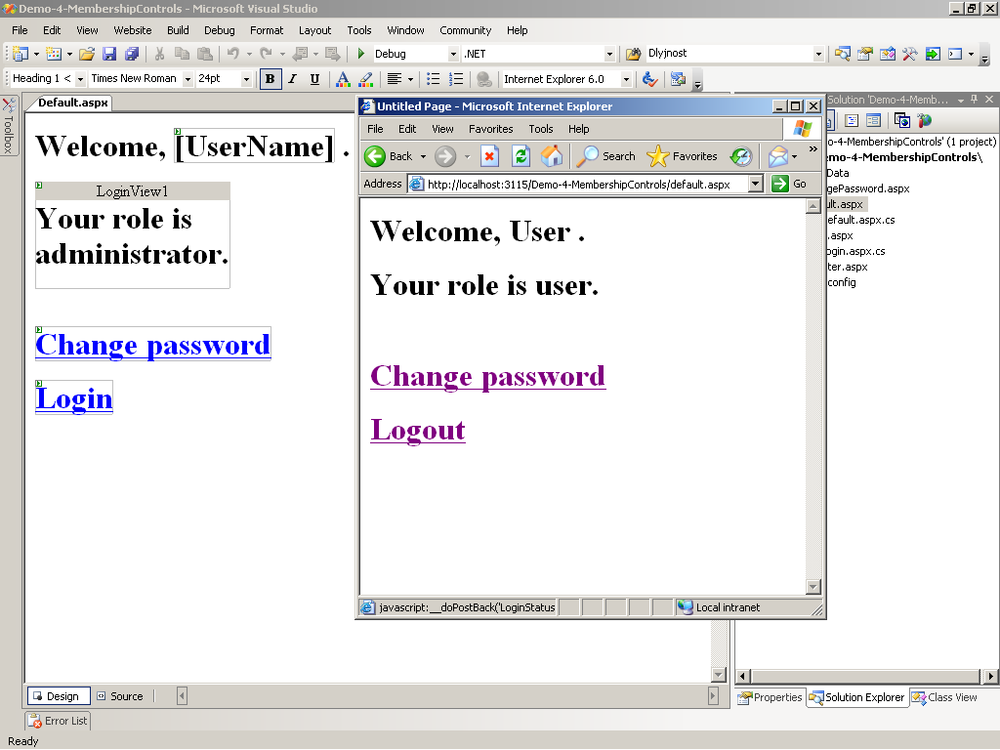
The LoginName and LoginStatus Control

Slide 37
The LoginView Control
Customized information which will be shown to users through templates, based on their roles
By default there are AnonymousTemplate and LoggedInTemplate
New custom templates can be added
To add the control to the page use:
<asp:LoginView id="MyLoginView" runat="server">
</asp:LoginView>

Slide 38
The CreateUserWizard Control
It is used to create new accounts
It works with the membership provider class
Offers many customizable features
Can quickly be added to and used using
<asp:CreateUserWizard id="NewUserWiz" runat="server">
</asp:CreateUserWizard>

Slide 39
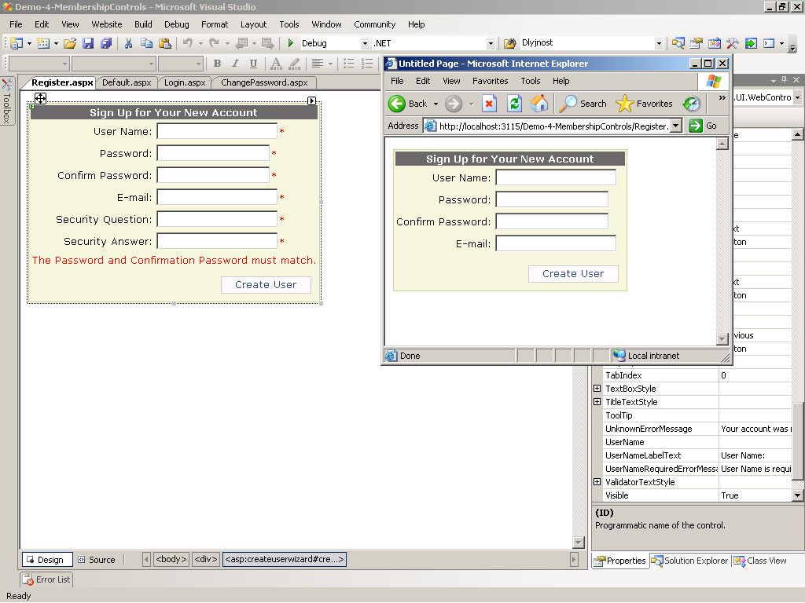
The CreateUserWizard Control (2)

Slide 40
The PasswordRecovery Control
It is used to retrieve passwords
The user is first prompted to enter username
Once users enter valid user names, they must answer their secret questions
The password is sent via e-mail
To add this control use:
<asp:PasswordRecovery id="prForgotPass" runat="server">
</asp:PasswordRecovery>

Slide 41
The ChangePassword Control
Allows users to change their passwords
It uses the membership provider specified in the Web.config
Can be added to any page with the following tag:
<asp:ChangePassword id="cpChangePass" runat="server"/>

Slide 42
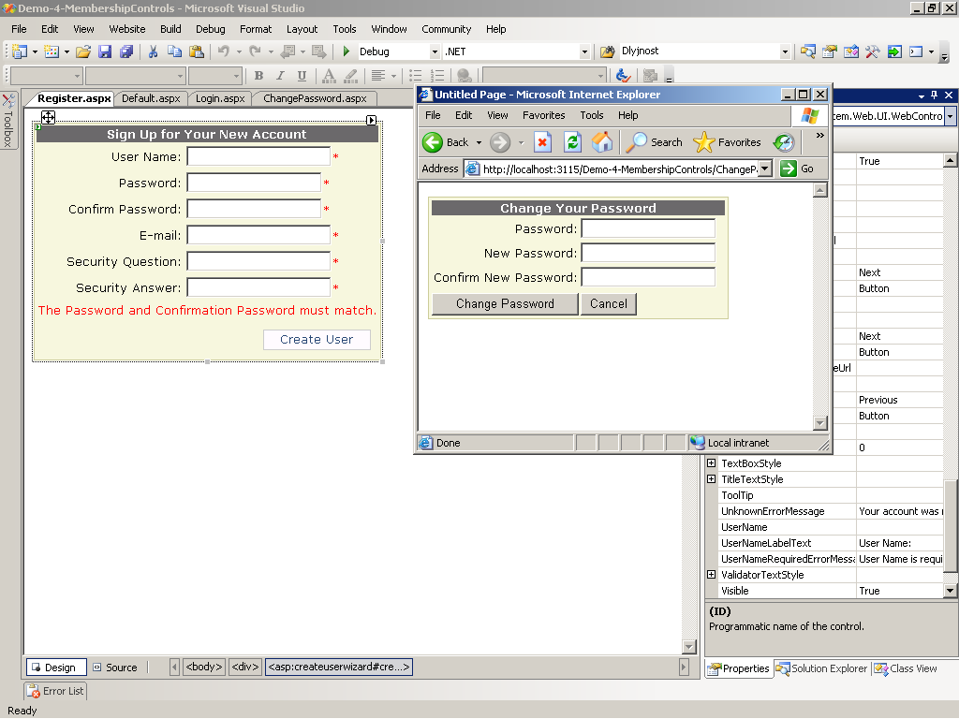
The ChangePassword Control

Slide 43

Authentication & Authorization
Questions?

Slide 44
Exercises
Create a database School in SQL Server. Using aspnet_regsql.exe add the SQL Server membership tables to support users / roles.
Using the ASP.NET Web Site Configuration Tool create a new role "Student" and two users that have the new role. Create a login page and try to enter the site with one of these two accounts.
Create a Web site and restrict access to a it for unregistered users. Implement login page, user registration page and logout link in the master page. The site should have the following pages:

Slide 45
Exercises (2)
Login.aspx – accessible to everyone
Register.aspx – accessible to everyone – allows visitors to register
Main.aspx – accessible to logged-in users only
Admin.aspx – accessible to Administrators roles only – allows users to be listed and deleted
Implement a site map and navigation menu that defines the pages in the Web site and specifies which pages which roles require. Hide the inaccessible pages from the navigation.

Slide 46
Exercises (3)
Create your own membership provider that uses a database of your choice. Define the tables:
Users(ID, username, PasswordSHA1)
Roles(ID, Name)
Create the following ASP.NET pages:
Login.aspx – accessible to everyone
Register.aspx – accessible to Administrators only
Main.aspx – accessible to logged-in users only

